Slide 1

NANOPOROUS GRAPHENE STM IMAGES SIMULATION
Marc Manau Esteban

Slide 2
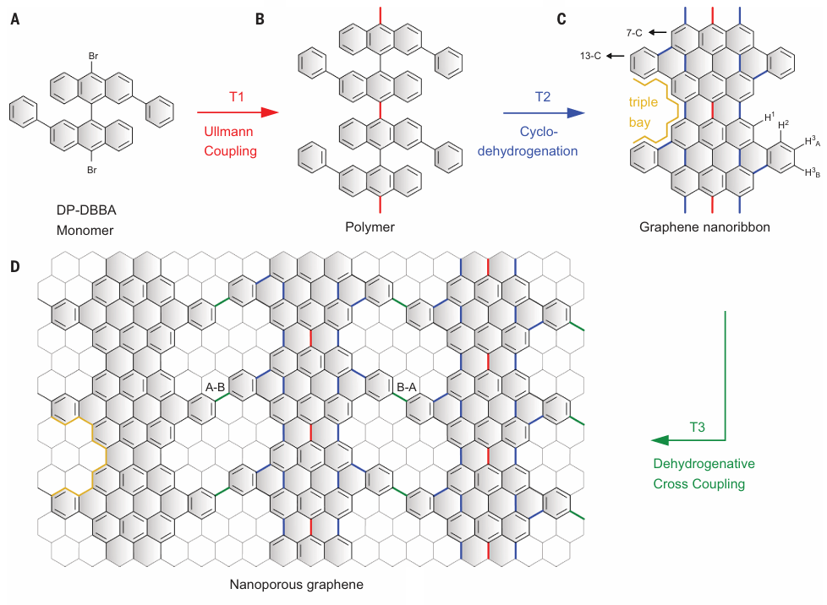
BOTTOM-UP NPG SYNTHESIS

Slide 3
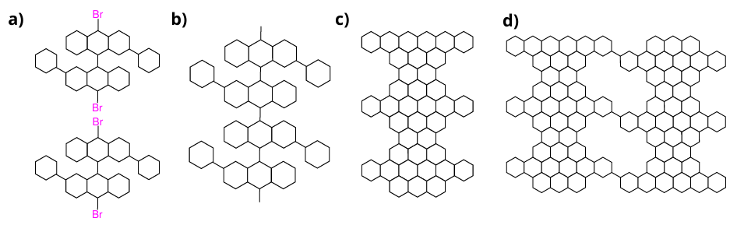
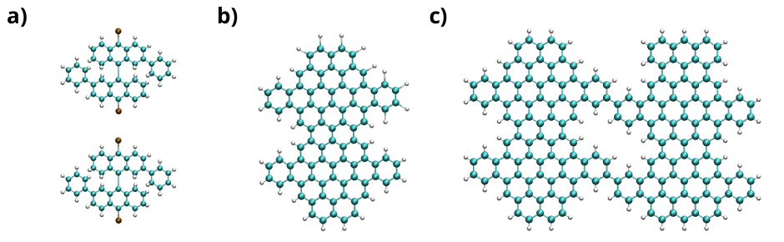
SYNTHESIS ROUTE STRUCTURES

Slide 4
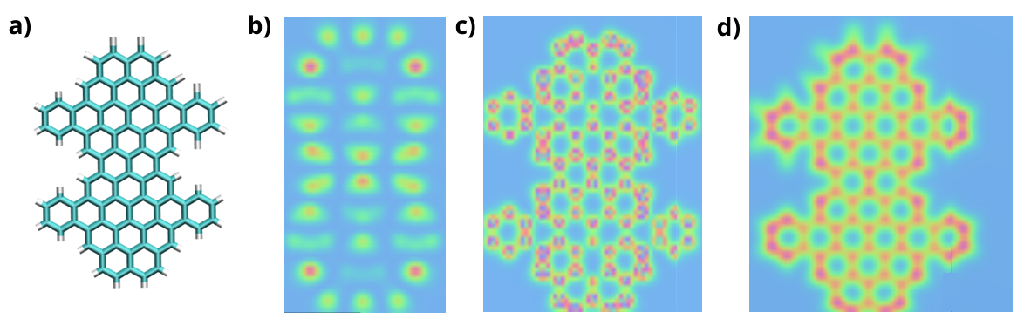
7 AND 13 CARBON ARMCHAIR GNR

Slide 5
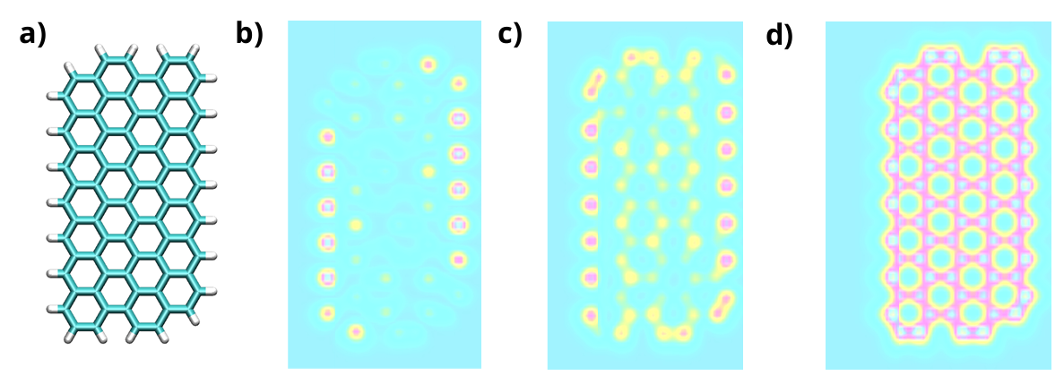
5 ZIGZAG GNR

Slide 6
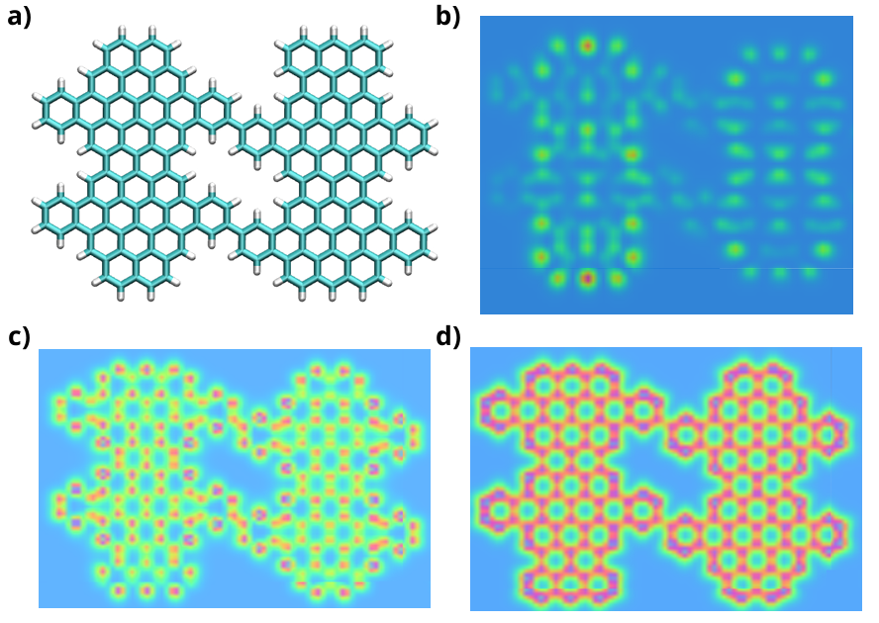
NPG STM IMAGES

Slide 7
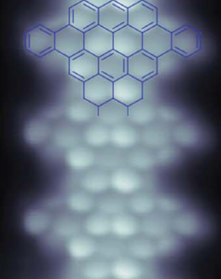
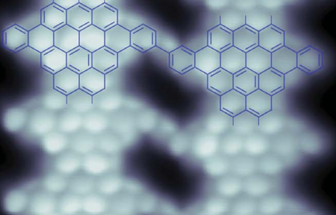
NPG STM IMAGES COMPARISON

Slide 8
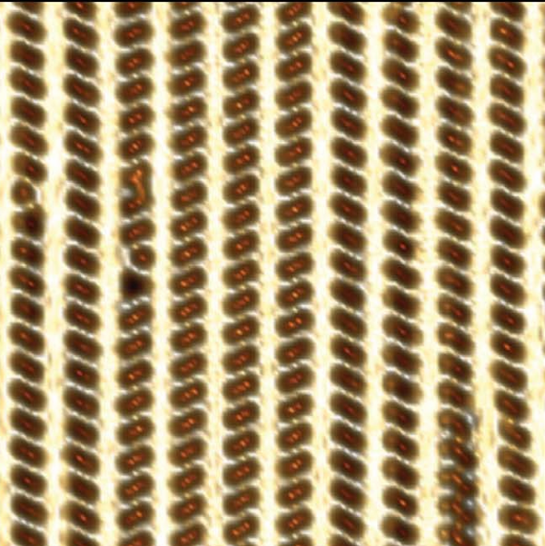
THANK YOU FOR YOUR ATTENTION
Moreno, C., Vilas-Varela, M., Kretz, B., Garcia-Lekue, A., Costache, M. V., Paradinas, M., Panighel, M., Ceballos, G.,Valenzuela, S. O., Peña, D., & Mugarza, A. (2018). Bottom-up synthesis of multifunctional nanoporous graphene. Science, 360(6385), 199-203.

